Slide 1
CAR ACCIDENT SEVERITY
-Astrid Ferreira

Slide 2
INTRODUCTION
Every year car accidents cause hundreds of thousands of deaths worldwide. Ac-cording to a research conducted by the World Health Organization (WHO) there were 1.35 million road traffic deaths globally in 2016, with millions more sustaining serious injuries and living with long-term adverse health consequences. Globally, road traffic crashes are a leading cause of death among young people, and the main cause of death among those aged 15{29 years. Road traffic injuries are currently estimated to be the eighth leading cause of death across all age groups globally, and are predicted to become the seventh leading cause of death by 2030[1].
Leveraging the tools and all the information nowadays available, an extensive analysis to predict traffic accidents and its severity would make a difference to the death toll. Analyzing a signi cant range of factors, including weather conditions, locality, type of road and lighting among others, an accurate prediction of the severity of the accidents can be performed. Thus, trends that commonly lead to severe traffic incidents can help identifying the highly severe accidents. This kind of information could be used by emergency services, to send the exact required sta and equipment to the place of the accident, leaving more resources available for accidents occurring simultaneously. Moreover, this severe accident situation can be warned to nearby hospitals which can have all the equipment ready for a severe intervention in advance.

Slide 3
OBSTACLE
Data that might contribute to determining the likeliness of a potential accident occurring might include information on previous accidents such as road conditions, weather conditions, exact time and place of the accident, type of vehicles involved in the accident, information on the users involved in the accident and o course the severity of the accident. This projects aims to forecast the severity of accidents with previous information that could be given by a witness informing the emergency services.

Slide 4
INTEREST
Governments should be highly interested in accurate predictions of the severity of an accident, in order to reduce the time of arrival and to make a more e cient use of the resources, and thus save a signi cant amount of people each year. Others interested could be private companies investing in technologies aiming to improve road safeness.

Slide 5
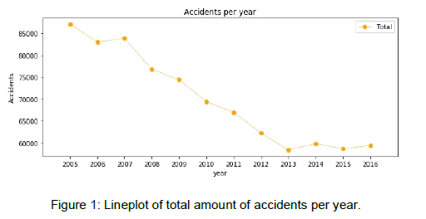
TOTAL ACCIDENTS PER YEAR

Slide 6
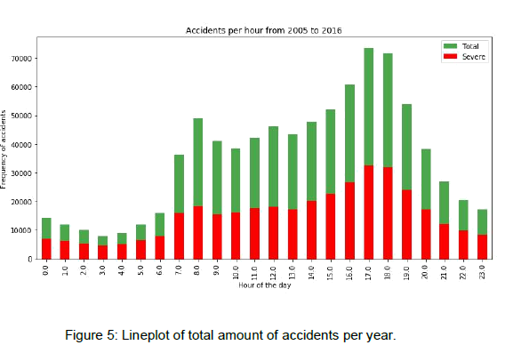
ACCIDENTS PER YEAR

Slide 7
RESULTS
The metrics used to compare the accuracy of the models are the Jaccard Score, f1-score, Precision1 and Recall2. This table reports the results of the evaluation of each model. Algorithm Jaccard f1-score Precision Recall Time(s)
Random Forest 0.722 0.72 0.724 0.591 6.588
Logistic Regression 0.661 0.65 0.667 0.456 6.530
KNN 0.664 0.66 0.652 0.506 200.58
SVM 0.659 0.65 0.630 0.528 403.92

Slide 8
CONCLUSION
In this study, I analyzed the relationship between severity of an accident and some characteristics which describe the situation that involved the accident. Initially I thought that features such as atmospheric conditions, the lighting or being a holiday would be the most relevant ones, yet I identified the department, the day and time of the accident, the road category and type of collision among the most important features that affect to the gravity of the accident.
I built and compared 4 different classification models to predict whether an accident would have a high or low severity. These models can have multiple application in real life. For instance, imagine that emergency services have a application with some default features such as date, time and department/municipality and then with the information given by the witness calling to inform on the accident they could predict the severity of the accident before getting there and so alert nearby hospitals and prepare with the necessary equipment and staff.
Also by identifying the features that favor the most the gravity of an accident, these could be tackled by improving road conditions or increasing the awareness of the population.

